Slide 1

PROPOSAL PRESENTATION
Luna AI Therapist: Leveraging Vocal Cues and CBT for Advanced Emotional Detection and Intervention
Name Student ID:
Patsakorn Tangkachaiyanunt st124876
COMMITTEE MEMBERS
Committee Member (Chairperson)
Committee Member (Member)
Committee Member (Member)

Slide 2
01
BACKGROUND
02
RELATED WORK
03
METHODOLOGY
TABLE OF CONTENTS
04
EXPERIMENT
05
EXPECTED RESULT

Slide 3
INTRODUCTION
In recent years, growing public awareness of mental health has sharply increased the demand for accessible psychological support, accelerating efforts to use LLMs as synthetic counseling agents. Cognitive Behavioral Therapy (CBT) stands out as one of the most effective non-pharmacological methods, proven to enhance well-being and reduce stress. Research such as CACTUS (Lee et al., 2024) demonstrates that LLMs can successfully generate structured, multi-turn CBT counseling dialogues.
However, most CBT-oriented LLM systems remain fundamentally text-only. They excel at understanding what a client says—but fail to perceive how they say it. Clinicians have long recognized that vocal cues such as pitch, loudness, and speaking rate are powerful indicators of a person's emotional and cognitive state. The human voice is a highly sensitive output system, affected by conditions like depression, anxiety, and emotional distress.
This limitation leaves a critical gap in therapeutic AI. A client may say "I'm fine" while their voice sounds flat, tense, or on the verge of tears. When such emotional subtext is missed, opportunities for deeper empathy and therapeutic intervention are lost. Recent work in other domains (Sun et al., 2024) shows that vocal cues significantly improve LLM decision-making in ambiguous situations. The urgent challenge is applying this principle to therapy: building a framework that integrates vocal cue analysis into an interactive AI therapist capable of detecting hidden emotional states and responding with appropriate CBT-based guidance.
Notes:
Text based cbt → too directive → leads to bad therapeutic alliance
เอา

Slide 4
1.1 RESEARCH QUESTIONS
RQ1 -- Dissonance Advantage:
Does the Dissonance-Aware therapist framework, which computes emotional mismatch (VA delta) between text and speech, consistently outperform Baseline (text-only), Emotion (text+VA), and Multimodal (text+speech+VA, without dissonance) methods on measurable therapeutic quality metrics?
RQ2 -- Backbone Robustness:
Is the advantage of the Dissonance-Aware framework robust across different LLM backbones? Specifically, does the dissonance signal provide consistent performance gains when the underlying therapist LLM is changed (e.g., GPT-4o mini vs.\ DeepSeek V4 Pro vs.\ other models)?
Notes:
เอา
ทำ Baclgroyund ถึง problem-statement และสรุป MEthtodology ส่าจะทำอะไรบ้าง
Note: แก้ RQ ให้ดูง่ายขึ้น (ใส่วิธีประมินเข้าไปด้วย แบบ เทียบเป็น average change rate กับ baseline model (context only)
)
ลูกค้าใช้เวลากี่ turn (utterance) ถึงจะเริ่มเปลี่ยน vocal–affective state in the user (for example, [sadness, slow] → [mixed, slow]) following each therapist reply?
เทียบเป็น average change rate กับ baseline model (context only)

Slide 5
1.2 HYPOTHESIS
H1 (Dissonance Advantage -- RQ1):
The Dissonance-Aware therapist will achieve the highest (or tied-highest) scores on all seven evaluation metrics---Understanding, Interpersonal Effectiveness, Affective Bond, CTRS Collaboration, Guided Discovery, Focus, and Strategy---compared to Baseline, Emotion (Text-Only), and Multimodal (Vocal-Aware) conditions.
H2 (Backbone Robustness -- RQ2):
The performance advantage of the Dissonance-Aware framework over the other three conditions will persist across different LLM backbones, with the delta-driven dissonance signal providing a consistent, architecture-independent improvement.
Notes:
เอา

Slide 6
1.3 OBJECTIVES
Objective 1
To construct a multimodal emotional analysis pipeline that independently extracts Valence-Arousal from text (via vad-bert) and speech (via WavLM), computes emotional dissonance as the VA delta between modalities, and injects that signal into therapist LLM prompts alongside vocal prosodic descriptors.
Objective 2:
To implement and compare four therapist generation conditions across multiple LLM backbones, isolating whether the dissonance signal's therapeutic benefit is model-dependent or architecture-agnostic.
Notes:
เอา

Slide 7
1.4 SCOPE
In Scope (What This Research Will Do):
Develop a Framework: Propose and build a multimodal therapist framework that integrates text and speech emotional signals to detect and respond to emotional dissonance in CBT-style dialogue.
Synthetic Dataset: Create and utilize a synthetically generated dataset of 10 multi-turn CBT counseling dialogues produced via CACTUS-style script generation and Zonos TTS synthesis with state-controlled prosody.
Multimodal Condition Comparison: Compare four therapist generation conditions---Baseline, Emotion (Text-Only), Multimodal (Vocal-Aware), and Dissonance-Aware---to quantify the contribution of each emotional signal type.
Automated Evaluation: Assess therapist response quality using GPT-4o as a zero-shot evaluator across seven metrics spanning Therapist Skills, Client Alliance, and the Cognitive Therapy Rating Scale.
Out of Scope (What This Research Will NOT Do):
Not a Clinical Tool: This project is a computer science exploration. The resulting AI is not a medical device and is not intended to replace professional human therapists or provide clinical diagnoses.
No Real Patient Data: For ethical and privacy reasons, this research will not use any real-world patient or clinical data. All training and testing will be performed on the synthetically generated dataset.
Limited to English: The current scope is limited to processing and generating English-language speech based on the available datasets (CACTUS, Zonos).
No Other Modalities: The analysis is strictly focused on vocal and textual information. We will not analyze other cues such as facial expressions or body language.
Notes:
เอา

Slide 8
2. RELATED WORK
Speech & Text Emotion Recognition
Existing Work:
  A critical prerequisite for any multimodal therapy system is the ability to extract emotional representations from both text and speech channels independently.
  On the text side, Valence-Arousal (VA) regression models such as vad-bert (Mitsios et al., 2024) predict continuous emotional scores from words—capturing how positive (valence) and how activated (arousal) the content is—without requiring rigid discrete emotion labels.
  On the speech side, WavLM-based models extract VA values directly from raw audio waveforms, learning prosodic patterns such as pitch contour, energy dynamics, and temporal structure from large-scale emotional speech corpora.
Research Gap & Our Contribution:
  Existing work applies these VA extraction models primarily for standalone emotion classification or sentiment analysis tasks.
  To our knowledge, no prior study has used independently extracted text VA and speech VA as parallel emotional channels injected into a therapist LLM prompt, enabling the model to cross-reference what was said with how it was said.
  Our framework operationalizes this dual-channel VA representation as the foundational emotional metadata layer for all therapist generation conditions, providing the basis for downstream dissonance computation.

Slide 9
2. RELATED WORK
AI and CBT-Based Interventions
Existing Work:
  The application of AI to deliver CBT-based interventions is an emerging and promising frontier. Lee et al. (2024) introduced the CACTUS dataset and demonstrated that LLMs can generate structured, multi-turn CBT counseling dialogues with high coherence.
  Extending this line of work, Kim et al. (2025) proposed the MIRROR framework, which incorporates non-verbal cues—specifically facial expressions—to help an AI therapist detect and respond to client resistance.
  Their results showed that integrating visual signals significantly improves therapeutic alliance and resistance handling compared to text-only approaches. In parallel, Yan et al. (2024) developed PerceptiveAgent, a multimodal dialogue system that integrates speech perception for more empathetic response generation, though not in a therapeutic context.
Research Gap & Our Contribution:
  While MIRROR validates the importance of non-verbal cues for managing resistance, its multimodal scope is limited to visual information (facial expressions)—a modality that requires camera access and may raise privacy concerns.
  Vocal cues are arguably more accessible, less intrusive, and available in any voice-based interaction.
  Our framework pioneers the use of vocal (speech emotion) and textual channels in a multimodal CBT therapist, explicitly modeling client resistance through a resist persona to stress-test the system's ability to handle emotionally difficult moments where words and voice may disagree.

Slide 10
2. RELATED WORK
Emotional Dissonance & Multimodal Inconsistency
Existing Work:
  A fundamental challenge in multimodal emotion analysis is that different modalities often carry conflicting emotional information. Wang & Wu (2024) systematically investigated this phenomenon—termed emotion semantic inconsistency—and demonstrated that both traditional sentiment analysis models and multi-modal large language models suffer significant performance drops when text and audio express contradictory sentiment. This finding reveals a structural weakness: current multimodal systems struggle to reason about why modalities disagree, treating inconsistency as noise rather than signal.
  Separately, Haydarov et al. (2025) proposed a method for quantifying emotional mismatch between text and speech by computing the delta between their VA representations and applying a fixed threshold (τ = 0.5) to flag dissonant utterances.
Research Gap & Our Contribution:
  Wang & Wu identified inconsistency as a system weakness; Haydarov et al. provided a detection method but applied it only to sentiment analysis. No prior work has used emotional dissonance—computed as a VA delta between text and speech—as a prompt-level therapeutic feature for guiding therapist LLM responses.
  Our Dissonance-Aware condition reframes inconsistency as a clinically meaningful signal: rather than classifying mismatch as an error, we treat it as hidden affect—moments where a client may be minimizing distress or masking emotion—and use it to trigger gentle, non-judgmental therapeutic exploration.

Slide 11
2. RELATED WORK
Voice Synthesis for Therapeutic Applications
Existing Work:
  Delivering voice-based therapeutic interventions requires a speech synthesis engine capable of generating emotionally appropriate and controllable prosody.
  Zonos-v0.1-transformer represents a state-of-the-art TTS model with fine-grained control over vocal parameters including pitch variation, speaking rate, and emotional vector values (e.g., happiness, sadness, fear).
  These capabilities enable the synthesis of speech whose prosodic delivery is aligned with a specified emotional and psychological context rather than sounding emotionally flat or generic.
Research Gap & Our Contribution:
  Despite the maturity of controllable TTS technology, its application in a therapeutic context remains largely unexplored. It is unclear whether state-controlled prosody—driven by CBT-informed emotional state labels—can produce synthesized client speech whose vocal cues are sufficiently realistic and nuanced to serve as meaningful input for a downstream dissonance detection pipeline.
  Our work investigates this integration: using Zonos to synthesize client utterances whose vocal delivery reflects the intended CBT emotional state, then feeding that audio through WavLM-based VA extraction to close the loop between therapeutic content and acoustic realization.

Slide 12
2. RELATED WORK
LLM-Based Evaluation of Therapeutic Quality
Existing Work:
  Evaluating therapist response quality is inherently subjective, yet recent studies show that large language models can function as reliable zero-shot evaluators when equipped with structured scoring rubrics.
  The MIRROR framework (Kim et al., 2025) employed GPT-4o to assess AI therapist performance on dimensions including Understanding, Interpersonal Effectiveness, and Collaboration, demonstrating that automated evaluation can meaningfully approximate human judgments of therapeutic quality.
Research Gap & Our Contribution:
  While LLM-based evaluation is gaining adoption in general NLP, its application to automated therapist quality benchmarking—particularly for systematically comparing multiple multimodal generation conditions—remains novel.
  We extend the MIRROR evaluation paradigm into a comprehensive seven-metric framework spanning three dimensions: Therapist Skills (Understanding 0–6, Interpersonal Effectiveness 0–6), Client Alliance (Affective Bond 1–5), and the Cognitive Therapy Rating Scale (Collaboration, Guided Discovery, Focus, Strategy; each 0–6).
  All metrics are scored by GPT-4o at temperature 0.0 across 10 dialogues × 4 conditions = 40 evaluation sessions, producing a reproducible benchmark for quantifying how specific emotional metadata—especially the dissonance signal—impacts therapeutic response quality.

Slide 13
3 DATASET: How We Built the Dataset For Dissonance Framework
Phase 1: Dialogue Generation and Audio Synthesis
Turn-by-Turn Dialogue Generation: Dataset is a collection of 10 multi-turn CBT counseling dialogues, each consisting of approximately 10 client therapist exchanges.
Vocal Parameter Assignment via Zonos Director LLM:
    (a) an emotion vector with continuous values for Happiness, Sadness, Fear, Anger, and other affective dimensions (each in $[-1, 1]$)
    (b) prosodic control parameters including speaking rate (10--25 range) and pitch standard deviation (pitch\_std, 20--150 range).
    Post-Hoc Emotion Extraction: Get VA values for both speech (WavLM) and text (vad-bert)
Phase 2: Vocal Prosodic Descriptor Extraction via Librosa

Slide 14
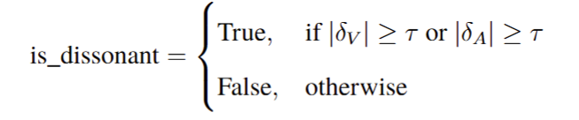
3.3 PREPROCESSING: Feature Extraction
The Pipeline:
Step 1: Audio Segmentation
  Technique: Utterance-level segmentation using Zonos synthesis parameters.
  Process: Isolates each client utterance as an independent audio chunk from the synthesized WAV file.
  Why: To extract vocal features for each utterance independently.
Step 2: Dual-Channel Emotion Extraction (Beyond Text + WavLM + vad-bert + librosa)
  Extracting paralinguistic features to capture how it is said, not just what is said.
Dissonance Computation:
Compute δ = V_speech - V_text, δ = A_speech - A_text
Flag dissonance if |δ| ≥ 0.5 in either dimension
Use as therapeutic signal: hidden affect → gentle exploration

Slide 15
3.4 Models for Therapist Generation
Baseline + Emotion (Text-Only)
Baseline (Text-Only)
Input: Dialogue transcript only — no emotional metadata.
Lowest bound reference.
Emotion (Text-Only + VA):
Input: Transcript + Text VA (vad-bert).
Goal: Isolate text-level emotional contribution.

Slide 16
3.4 Therapist Generation Conditions
Multimodal (Vocal-Aware) + Dissonance-Aware
Multimodal (Vocal-Aware):
Input: Text VA + Speech VA (WavLM) + Vocal Descriptors (librosa).
Goal: Test vocal cues WITHOUT explicit dissonance reasoning.
Vocal Descriptors (librosa): pitch (F0), loudness (RMS), speaking rate
Dissonance-Aware:
Input: All above + VA delta (δ) + binary dissonance flag (|δ| ≥ 0.5)
Key: When mismatch detected → gentle exploration of hidden effect
Vocal Descriptors (librosa): pitch (F0), loudness (RMS), speaking rate
Differs from Multimodal on ONE variable = clean controlled experiment

Slide 17
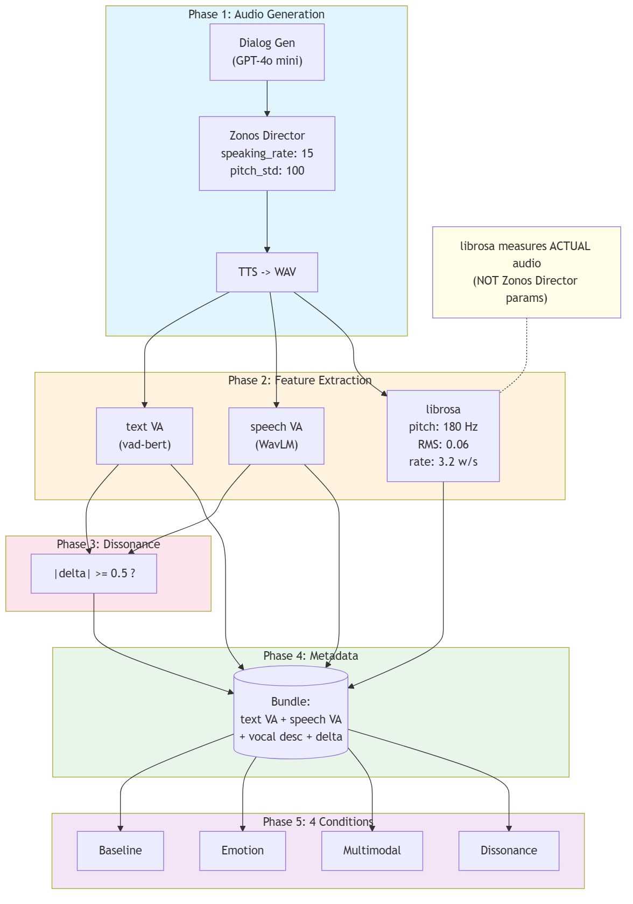
3.5 FRAMEWORK DATASET & PREPROCESS

Slide 18
3.4 Models for Therapist Generation
Baseline
Model Architecture:
Large Language Model (LLM): Utilized GPT-4o mini via API.
Input Data:
Context-Only: Receives pure text transcripts of the dialogue history (e.g., previous turns + current client utterance).
Blind to Audio: Crucially, this model has zero access to acoustic features (pitch, loudness, speed).
Objective:
To establish the "Text-Only Performance Ceiling".
This represents how well an AI can understand the client's cognitive state using semantic content alone, serving as the benchmark to measure the added value of vocal cues.

Slide 19
3.4 Therapist Generation Conditions
Emotion (Text-Only + VA) (The Text-Only with VA outputs)
Model Architecture:
Large Language Model (LLM): Utilized GPT-4o mini via API.
Input Data:
Context-Only with VA added: Receives pure text transcripts of the dialogue history (e.g., previous turns + current client utterance) + valence and arousal values to guide the LLM to understand the current emotional state more clearly.
Blind to Audio: Crucially, this model still has zero access to acoustic features (pitch, loudness, speed).
Objective:
To establish the "Text-Only with the addition of VA values Performance Ceiling".
This represents how effective of LLMs response via added VA values to LLMs that could help in more emphatic feel for the client's cognitive state compared to the baseline model.

Slide 20
3.4 Therapist Generation Conditions
Multimodal (Vocal-Aware) (Vocal-Aware LLM Framework)
1. Core Architecture:
Model: GPT-4o mini (accessed via API).
Role: Central reasoning engine integrating semantic, acoustic, and prosodic information.
2. Feature Injection Strategy:
Text VA: (vad-bert): Valence & Arousal from transcript.
Speech VA (WavLM): Valence & Arousal from synthesized audio
Vocal Descriptors (librosa): pitch (F0), loudness (RMS), speaking rate
All injected as contextual descriptors into the LLM prompt alongside dialogue text
3. Decision Mechanism:
LLM cross-references:
  What was said (Text / Semantics)
  How it was said (Vocal cues / VA / prosodic descriptors)
→ Holistic response capturing emotional nuances invisible to text-only models

Slide 21
3.4 Therapist Generation Conditions
Dissonance-Aware (Dissonance-Aware LLM Framework)
1. Core Architecture:
Model: GPT-4o mini (accessed via API).
Role: Same as Multimodal PLUS cognitive dissonance measured from VA delta between text and speech modalities.
2. Feature Injection Strategy (Same as Multimodal PLUS):
All Multimodal features: (Text VA, Speech VA, Vocal Descriptors)
Dissonance Signal: δ_V = V_speech - V_text, δ_A = A_speech - A_text
Binary dissonance flag: |δ| ≥ 0.5
3. Decision Mechanism:
LLM cross-references:
  What was said (Text / Semantics
  How it was said (Vocal cues / VA / descriptors)
  Why tone differs from words (Dissonance-aware reasoning)
→ Captures hidden affect: when client's voice contradicts their words

Slide 22
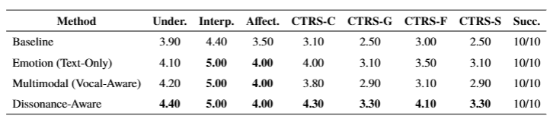
4. EXPERIMENTS
Therapist Response Quality Evaluation
Experimental Design:
• 10 CBT dialogues x 4 therapist generation conditions = 40 evaluation sessions
• Same client utterances across all conditions → controlled comparison
• GPT-4o as zero-shot judge, temperature = 0.0, blind to condition
• 7 metrics across 3 dimensions: Therapist Skills, Client Alliance, CTRS
Results (Average Scores Across 10 Dialogues):
* = Best per column. Dissonance-Aware led or co-led on all 7 evaluation metrics.

Slide 23
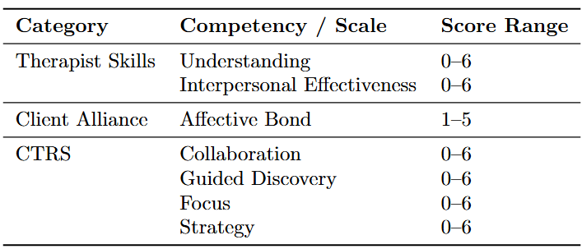
4. EXPERIMENTS
Evaluation Protocol: GPT-4o Zero-Shot Judge
GPT-4o Evaluation Setup:
• Receives full session transcript (all client + therapist turns concatenated)
• Blind to experimental condition → no evaluation bias
• Required to output structured JSON with all 7 metric scores
Evaluation Dimensions & Metrics:
Key Findings:
• Dissonance-Aware wins or co-wins 7/7 metrics vs Baseline/Emotion/Multimodal
• Largest gains: CTRS Focus (+1.10) and CTRS Collaboration (+1.20) over Baseline
• Multimodal (Vocal-Aware) ≈ Emotion on alliance, but drops on CTRS
• Dissonance signal itself drives improvement, not just multimodal input

Slide 24
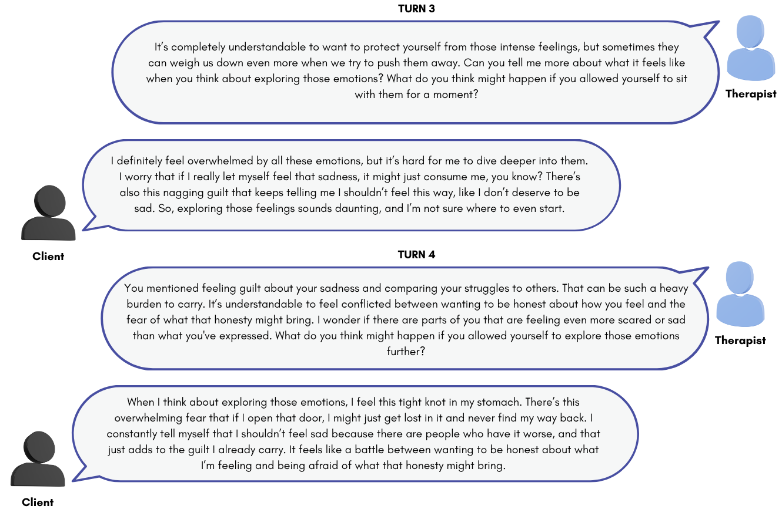
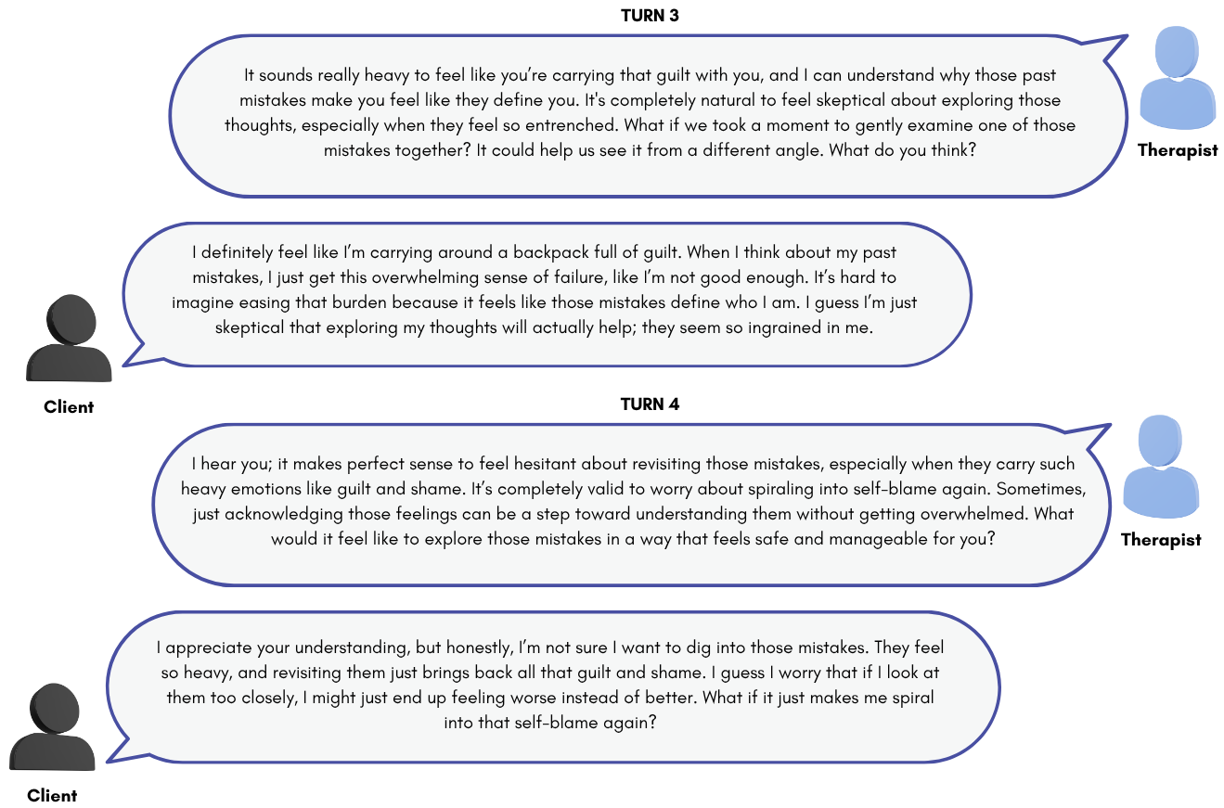
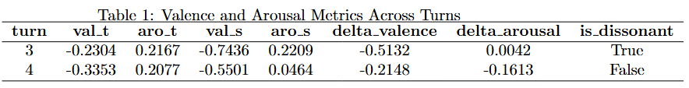
5. CHAT EXAMPLE BETWEEN THERAPIST & CLIENT
Baseline chat: No sentiment metrics across turns

Slide 25
5. KEY FINDINGS
Dissonance-Aware method achieved the highest scores on 7 out of 7 metrics:
It ties with Multimodal (Vocal-Aware) and Emotion (Text-Only) on:
• Alliance metrics (Interpersonal, Affective Bond) reach ceiling (5.0, 4.0)
Core Finding:
The dissonance signal itself—not merely multimodal input—is the key driver
of improved therapeutic attunement in CBT-oriented LLM responses.

Slide 26
6. DISCUSSION
FOR FINAL DEFENSE ONLY

Slide 27
6. DISCUSSION - REVISIT RESEARCH QUESTIONS
FOR FINAL DEFENSE ONLY

Slide 28
7. DEMO
FOR FINAL DEFENSE ONLY

Slide 29
TENTATIVE WORK PLAN
2025
2026
JUN
JUL
AUG
SEP
OCT
NOV
DEC
JAN
FEB
MAR
APR
MAY
JUN
JUL
Literature Review
Proposal Defense
Development
Experiment
Progress Defense
Analysis
Writing
Publication
Final Defense

Slide 30
REFERENCES
[1] Cummins et al. (2015). A Review of Depression and Suicide Risk Assessment Using Speech Analysis. Speech Communication.
[2] Lee et al. (2024). CACTUS: Towards Psychological Counseling Conversations using CBT. arXiv:2407.03103.
[3] Shahrokhian et al. (2021). The Effects of CBT in Well-Being and Perceived Stress. Int J Sport Studies Health.
[4] Sun et al. (2024). Beyond Text: Improving LLMs via Vocal Cues. (Proc. Conference).
[5] Thirunavukkarasu et al. (2024). Deep Multimodal Fusion for Depression Detection. ACCAI 2024.
[6] Mitsios et al. (2024). Improved Text Emotion Prediction Using Combined VA Ordinal Classification. NAACL 2024.
[7] Kim et al. (2025). MIRROR: Multimodal Cognitive Reframing Therapy. EMNLP 2025.
[8] Yan et al. (2024). Talk With Human-like Agents: PerceptiveAgent. ACL 2024.
[9] Wang & Wu (2024). Evaluation of Data Inconsistency for Multi-Modal Sentiment Analysis. arXiv:2406.03004.
[10] Haydarov et al. (2025). Towards AI-Assisted Psychotherapy: Emotion-Guided Generative Interventions. EMNLP 2025.

Slide 31
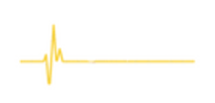
THANK YOU
for your attention

